Slide 1
Tutorial exercises
Each week you should
try to do the tutorial exercises in the labs – talk to your tutor if you are stuck
try to finish them off at home, if necessary
watch me working through selected solutions at the start of the lecture
review the solutions on Moodle – ask your tutor if you still don’t understand
try again to do any that you couldn’t do first time around
You don’t need to submit your solutions and there is no upload on Moodle – if you want feedback on your tutorial work or need help, just ask your tutor in the next COMP1753 lab.

Slide 2
Tutorial hints
You must unzip the examples zip files you download
in the labs, right click on the zip file and select 7 Zip > Extract Here
on your own computer you may need to use something else
if you don’t unzip them, IDLE won’t allow you to modify them ☹

Slide 3
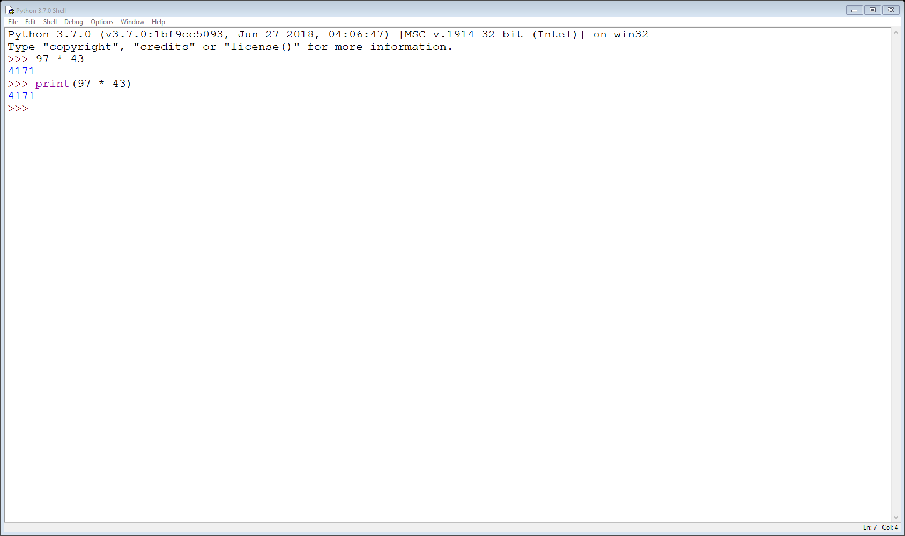
Tutorial hints (2)
The multiplication symbol is “*” (asterisk) and not “x”
You don’t need the print command to use Python as a calculator

Slide 4
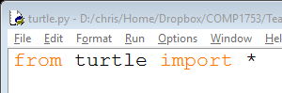
Tutorial hints (3)
Don’t name your any of your programs turtle.py
if you do they will not work as the program asks Python to import from itself!
the file is named turtle.py …
… and it is importing code from turtle.py

Slide 5
Tutorial hints (4)
Equilateral triangles
all the sides must be the same length, all the angles must be 120⁰
There are several ways to do other triangles
Scalene triangles (all sides different)
the hard (mathematical) way: put in two different lengths and then work out the length of third using cosines; the sum of the angles must add up to 360⁰
the easy (computational) way: put in two different lengths and then use the goto() command to take the turtle back to the point it first started at
Isosceles triangles (two sides the same)
same as scalene except put in two identical lengths

Slide 6
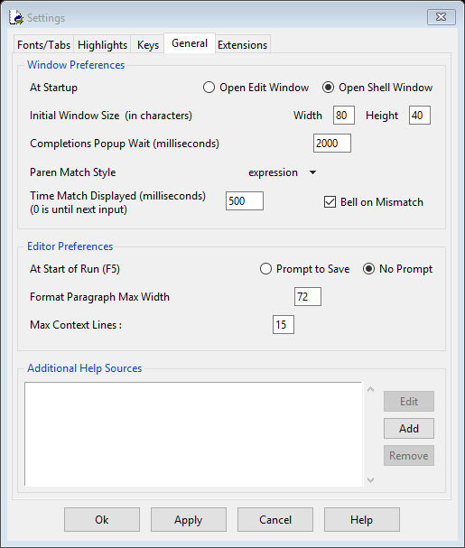
Tutorial hints (5)
After changing the code, IDLE prompts to save the file when you want to run it
this is a bit boring
Change with Options > Configure IDLE
General tab
change to No Prompt

Slide 7
Tutorial hints (6)
You can use speed() to speed up or slow down the turtle
speed(10) is fastest
speed(1) is slowest
speed(0) is instantaneous (ignores all animation and just draws the drawing)
see the Hexagon example

Slide 8
Variables
Chris Walshaw
Computing & Information Systems
University of Greenwich

Slide 9
Lecture Objectives
Variables
assigning
naming
Data types
strings & integers
conversions
Operators
Examples
working with strings & integers
calculator programs
random numbers

Slide 10
Double clicking
If you have Python installed on your computer then your .py files should be associated with Python
if you double-click a file it will start up a shell, run the code …
… and close the shell immediately before you have a chance to read the output
We will fix this by asking the user to press the return key before exiting
We can do this using the python command input()

Slide 11
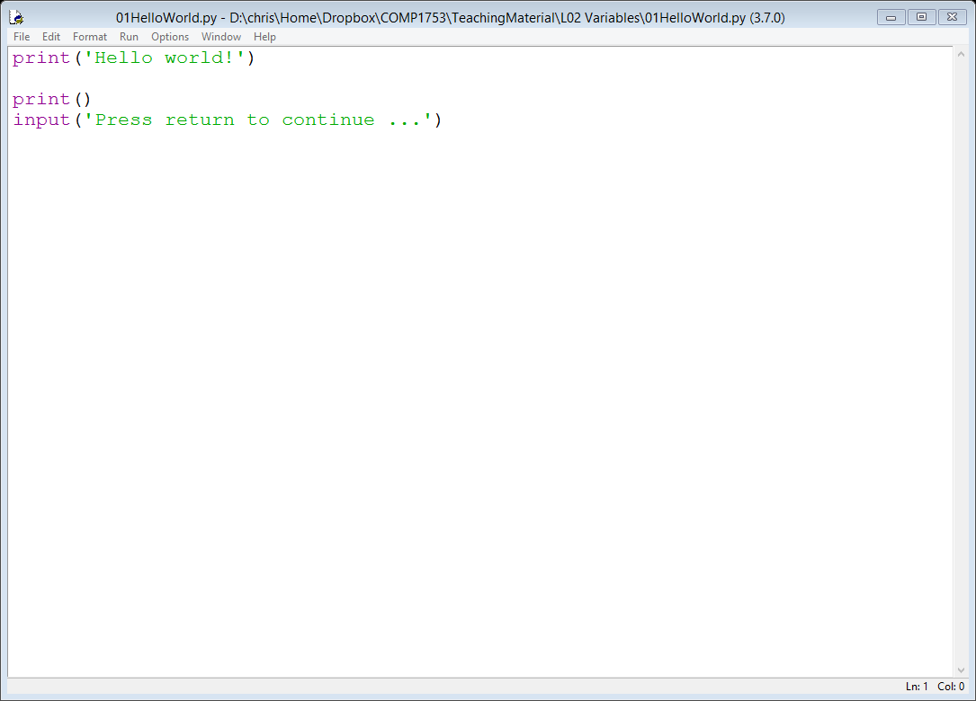
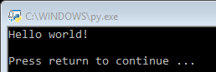
01HelloWorld new version
Here is the new version
Python will not go beyond the input line until the user has hit return
this is THE PROGRAM
and this just prints a blank line between the program and the prompt
this line prompts the user to hit return

Slide 12
Making use of the input
From now on, all the examples will have these two lines at the bottom so that you can run them by double-clicking
But input() is far more powerful than that!
we can use it to get any keyboard input from the user (not just return)

Slide 13
Motivation
01HelloWorld will only ever do one thing
print the words “Hello world!”
This is pretty boring and not very useful
we need our programs to respond to user input
e.g. cash machine, video game, etc
input() provides a way of getting keyboard input into our program
There are also ways to receive input from other devices
mouse (clicks/motion), touch screens, games consoles, ...
but we won’t cover them in this course

Slide 14
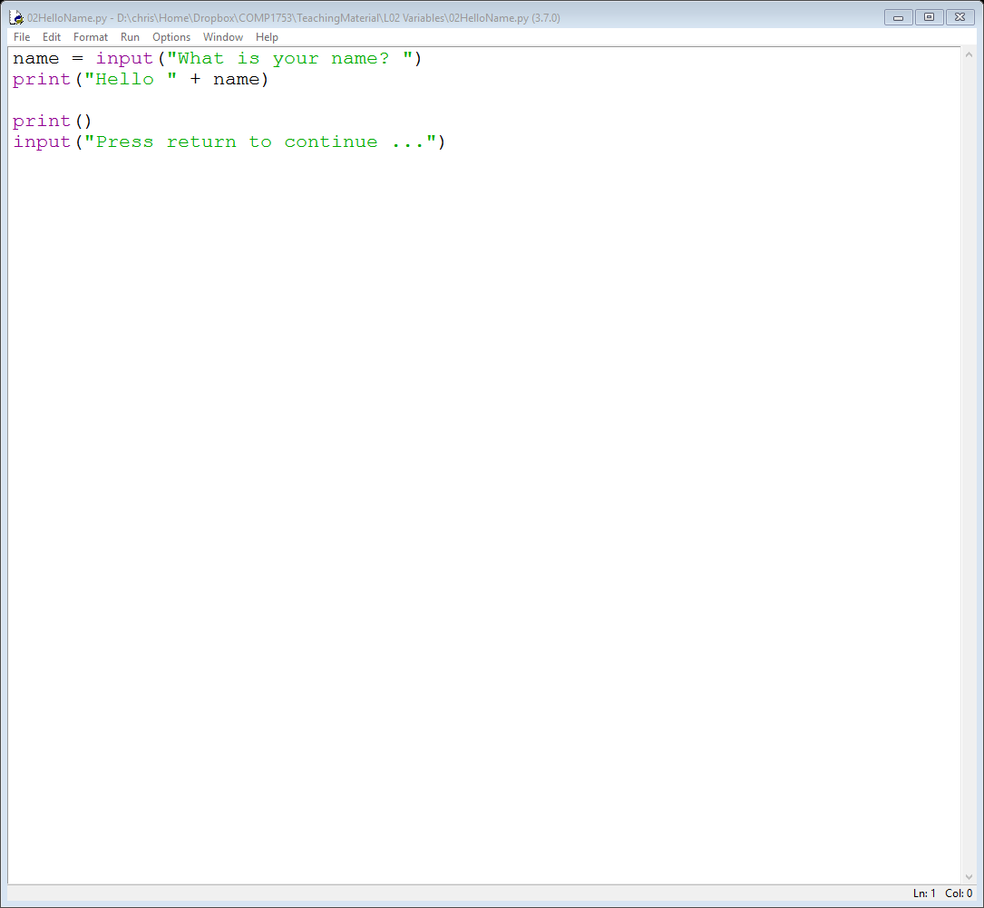
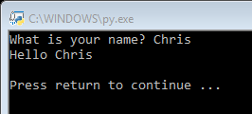
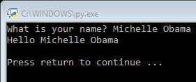
02HelloName
HelloName will output the word “Hello ” plus what the user types in
it doesn’t even need to be a single word

Slide 15
How?
In order to do this the program has to store (temporarily) a copy of what the user has typed in
This is achieved with something called a variable
A variable is a bit of temporary storage inside the program
think of it like a box in which a bit of data is stored
when the program is written we (as programmers) don’t know what will be stored in the box (it might be the word “Chris” or it might be the words “Michelle Obama”) – we just know something will need to be stored there

Slide 16
02HelloName
In HelloName, the variable is called name
It stores whatever the user types in and is then used to construct the output

Slide 17
Declaring variables?
Unlike other languages we don’t need to tell Python (declare) that name is a variable – it just figures it out
We also don’t need to tell Python what sort of data it stores (e.g. some text, a number, …)
Aside: in other languages, not only do you have to declare variables, you have to say what type of data you are going to store (e.g. int for a whole number, float for a decimal number, String for a bit of text, …)

Slide 18
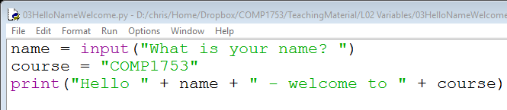
03HelloNameWelcome – assigning variables
In order to store data in a variable, use the “=”sign
can be something the user has typed in
can be something fixed
This is known as assigning a value to the variable
Note, the “=” sign does not work the same as in maths
in maths, read it as “is equal to”, e.g. E = mc²
in programming, read it as “is assigned the value”, e.g. course = "COMP1753";
“name” is typed in
“course” is fixed

Slide 19
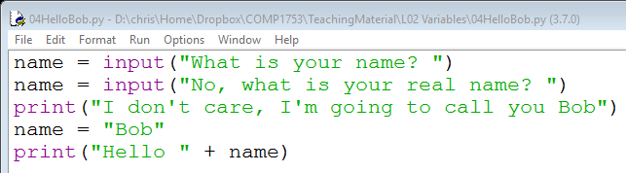
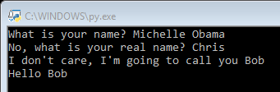
04HelloBob – (Re)Assigning variables
We can even change what is stored in the variable by assigning it again
assigned
reassigned
reassigned to a fixed value

Slide 20
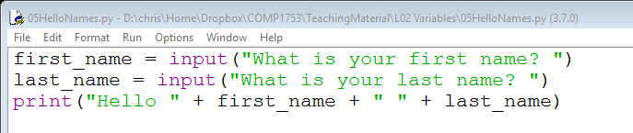
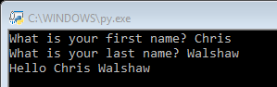
05HelloNames – lots of variables
A program can have several variables

Slide 21
Naming variables
A program may have hundreds or even thousands of variables
The programmer needs to give each of them a label (or name) so that they can be referred to
In HelloNames the labels are first_name & last_name
but they can be pretty much whatever we want, e.g. fish or teapot or alsdkfasj
However …

Slide 22
Naming variables – rules
A variable name must start with a letter or the underscore character
A variable name cannot start with a number
A variable name can only contain alpha-numeric characters and underscores (A-Z, a-z, 0-9, and _ )
Variable names are case-sensitive (name, Name and NAME are three different variables)
Variable names may not be Python identifiers, e.g.
words we have already seen such as from, import, …
words that we will meet later such as if, else, True, False, for, while, …
if a word is displayed orange in IDLE, it’s an identifier
https://www.w3schools.com/python/python_variables.asp

Slide 23
Naming variables – conventions
For variables which will change (most of them)
start the name with a lower case letter (so name rather than Name)
to run a number of words together, use underscores between each word (so first_name rather than firstname)
For “variables” which contain fixed values (which will never change)
use upper case throughout (so VAT rather than vat)
to run a number of words together, use an underscore to separate them (so VALUE_ADDED_TAX rather than VALUEADDEDTAX)
Above all, make variable names concise but meaningful (so first_name and last_name rather than n1 and n2)

Slide 24
Quick check
Which of these are legal variable names
first name
first_name
firstname
FirstName
_firstname
$firstname
1st_name
Which of the legal variable names above follow naming conventions
no
yes
legal and follows naming convention
yes
yes
yes
no
no

Slide 25
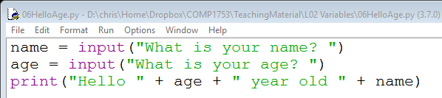

06HelloAge – “Numbers”
Variables can also be used to store “numbers”
But in this example 25 is not really a number (can’t add or multiply it) – it’s just more text
referred to as a string, i.e. a string of characters

Slide 26
Data types – Numbers
Strings of text are fine if we don’t want to do much with them
although they can be manipulated
However what if we want to build a calculator or do some data analysis?
We can’t add strings together and we certainly can’t multiply them
even if the strings contain numerical values
What we need is a data type that stores a number

Slide 27
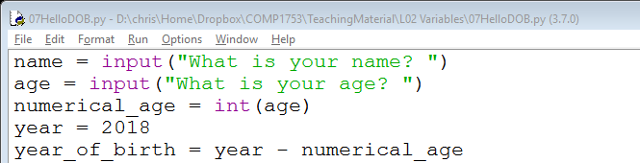
07HelloDOB – Integers
If we want to use some text as a number, we must convert it first
In the example below, int() converts age into an integer (a whole number)
age is text
numerical_age is an integer
year is an integer
because year and numerical_age are both integers we can do some arithmetic with them

Slide 28

07HelloDOB – Strings
Finally to output the calculation to the user, we must convert “year_of_birth” back to a string (i.e. some text) using str()
age is still a string – doesn’t need converting
but year_of_birth is an integer – needs converting to be used with the string "You were born in "
https://www.w3schools.com/python/python_casting.asp

Slide 29
Aside: temporary / permanent storage?
Notice that we temporarily store the age as an integer variable to do some work on it
Some variables may store the same value for the entire time that the program runs
Some variables may store a value which is updated as the program runs
Some variables may just be used temporarily
Think of a cash point machine
The name of the bank (for displaying on the screen) might be stored in a variable which never changes
The total amount of money left inside the machine is a single variable updated after each transaction
The money required by a customer is stored temporarily whilst the transaction is taking place but forgotten once the transaction has happened and the customer’s account has been updated in the database

Slide 30

Data types … so far
So far we have met strings
name and course are both variables which store strings
And now we have met integers
numerical_age, year and year_of_birth are variables which store integers

Slide 31
Strings vs integers
Python allows both strings & integers and figures out what to store based on the context
a_value = 25
some_text = "twenty five"
Anything in quote marks is a string
another_value = "25"
And (unlike most languages) Python lets you change the type of a variable
a_value = 25
a_value = "twenty five"
an integer
a string
a string!!
initialised with an integer
but now a string

Slide 32
Other data types
boolean values (true/false)
see next week
floating point numbers (decimals)
we may use these occasionally
complex numbers
we will not use these
https://www.w3schools.com/python/python_numbers.asp

Slide 33
Operators
Operators are used to perform operations (add, subtract, etc.) on variables and values
String operators include “+” which glues (concatenates) strings together
Numerical operators include +, -, * and / which add, subtract, multiply and divide numbers

Slide 34
HelloAge vs HelloDOB
Now we have got to grips with strings and integers we can make sense of the difference between HelloAge and HelloDOB
HelloAge just uses strings
HelloDOB converts the user’s age to an integer so that it can calculate the year of birth

Slide 35

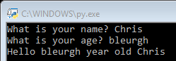
06HelloAge again
It doesn’t matter what you input as your age, HelloAge just uses the string in its output with no conversion

Slide 36
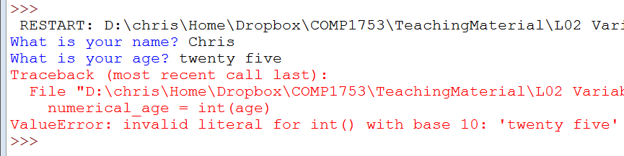
07HelloDOB again
Conversely HelloDOB needs a String which can be converted to an integer
Python isn’t smart enough to convert “twenty five” to a number

Slide 37
Calculator examples
We now have (nearly) all the tools we need to build a calculator program
as opposed to using the Python shell
In fact we will build 4 calculators
addition
subtraction
multiplication (tutorial exercise)
division (tutorial exercise)
Next week we will be able to combine them into one single program!

Slide 38
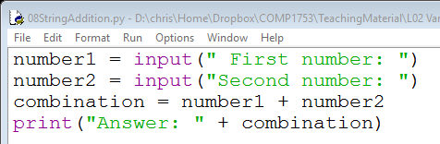

08StringAddition
The first example, StringAddition, just reinforces that you need to convert strings to integers
if you ‘add’ two strings together they just get concatenated (glued) together

Slide 39
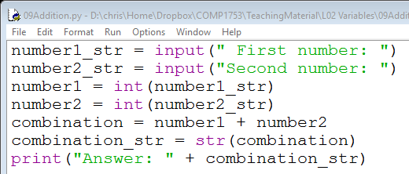

09Addition
So to add two strings which contain digits, first convert them to integers
using int()
Then convert back to a string to output
using str()

Slide 40


10Subtraction
Subtraction is virtually identical (except for the minus sign)

Slide 41
Short cuts
In Addition we have actually introduced 6 variables!
number1_str, number2_str, number1, number2, combination, combination_str
This could be considered excessive as they are all just temporary storage
In fact we can eliminate some by combining operations

Slide 42
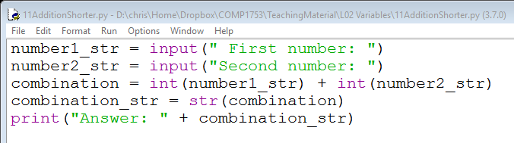
11AdditionShorter
AdditionShorter eliminates number1 & number2 by doing the conversions to integer at the same time as the addition

Slide 43
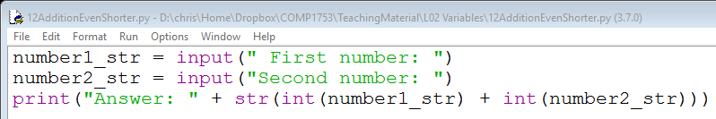
12AdditionEvenShorter
12AdditionEvenShorter eliminates combination & combination_str by doing the conversions & addition at the same time as writing the output

Slide 44
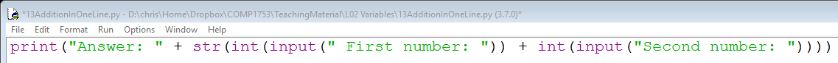
13AdditionOneLine
We can actually eliminate all the variables and write the code in one line!
But this is not really a good idea
hard to understand
hard to debug
Moral: it is fine to have lots of temporary variables if it makes the code clearer

Slide 45
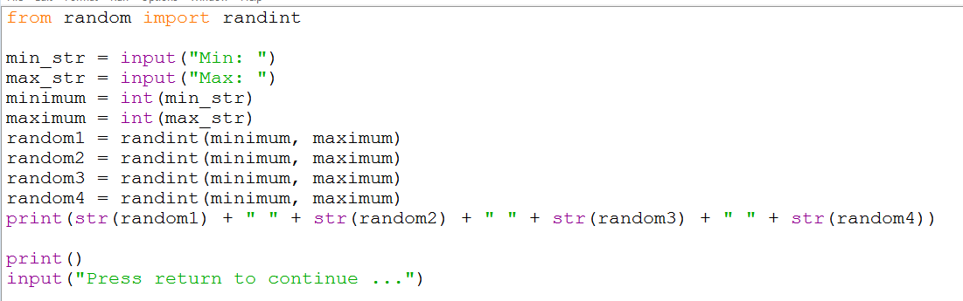


14RandomValues
Our final example uses the random module to generate 4 random numbers between values that the user chooses
We will use this example later in the course to illustrate a number of ideas

Slide 46
Summary
Variables
assigning
naming
Data types
strings & integers
conversions
Operators
Examples
working with strings & integers
calculator programs
random numbers

